Slide 1


Slide 2


Slide 3


Slide 4
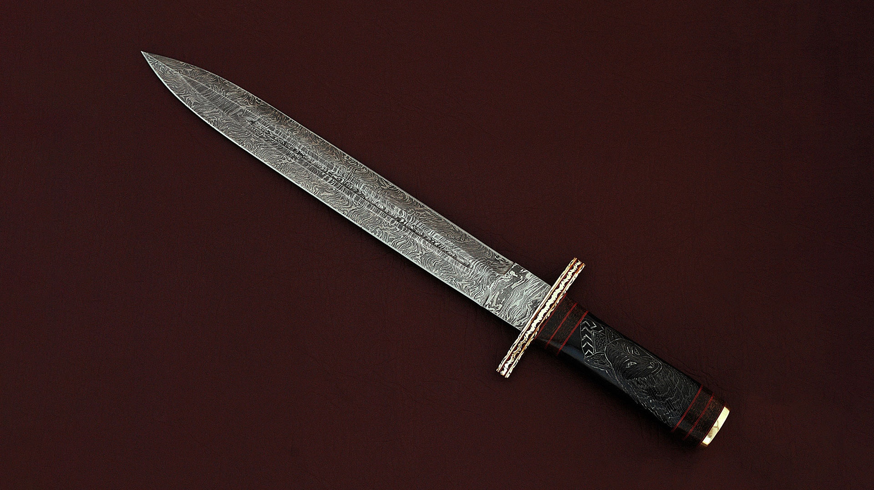

Slide 5
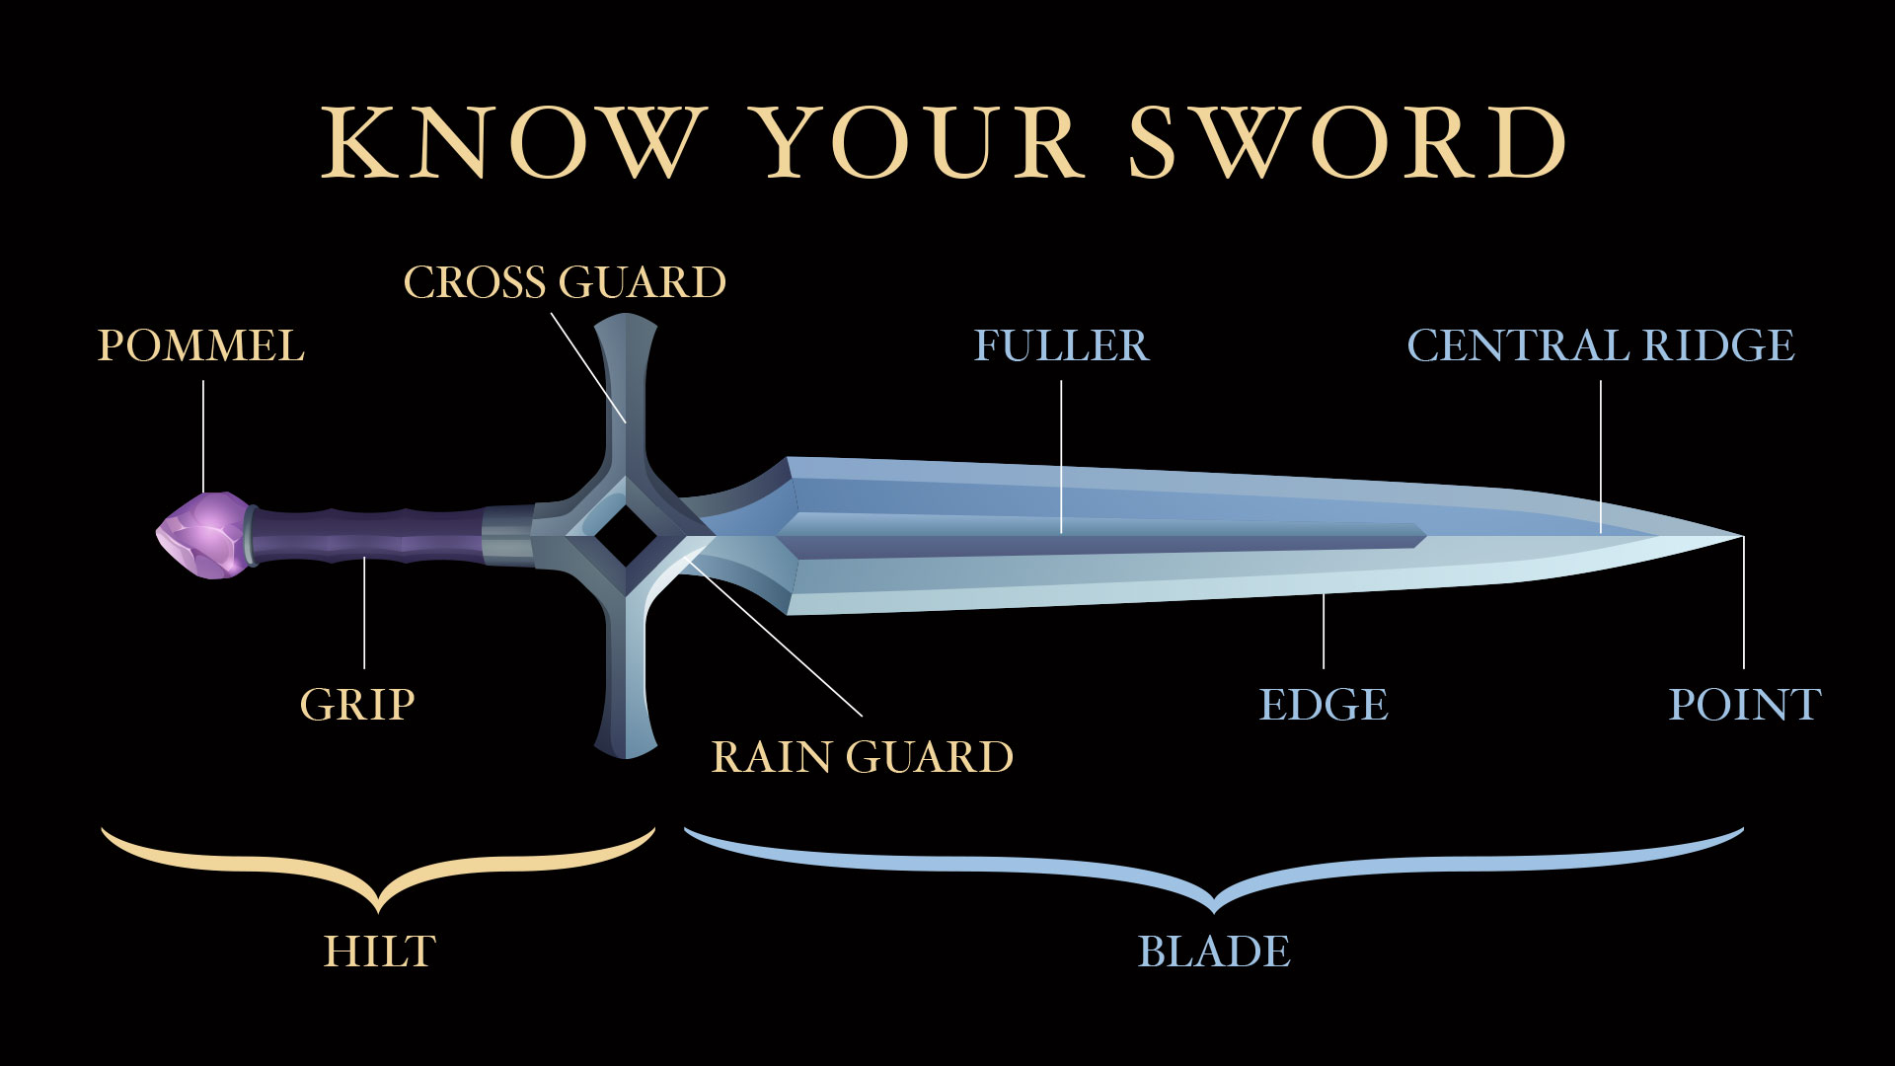

Slide 6


Slide 7


Slide 8


Slide 9


Slide 10


Slide 11


Slide 12


Slide 13


Slide 14


Slide 16
The additional slides below are
provided so the PowerPoint can be adapted to best fit your needs.

Slide 17


Slide 18


